Slide 1
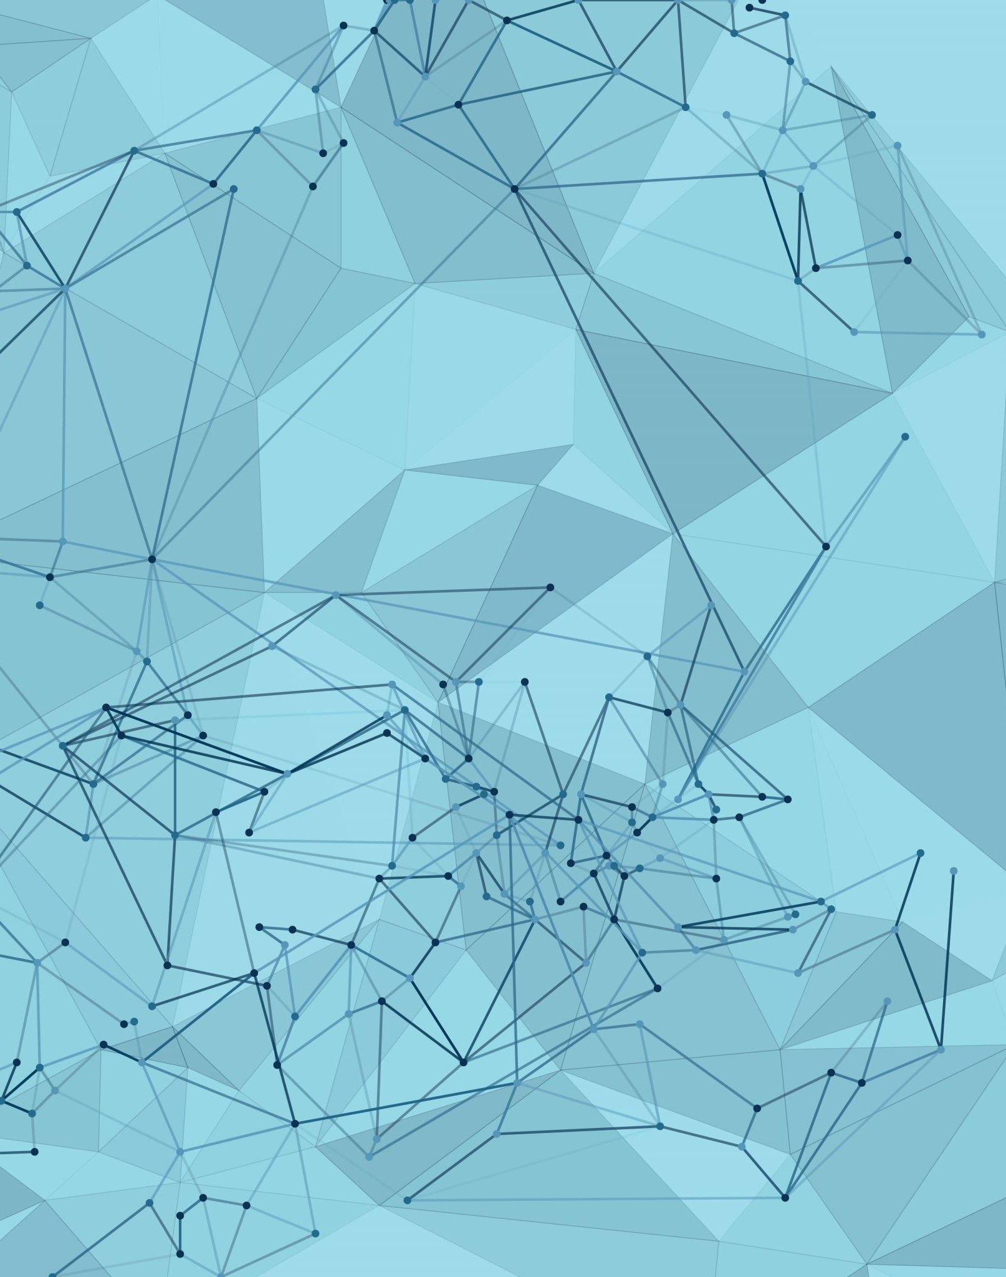
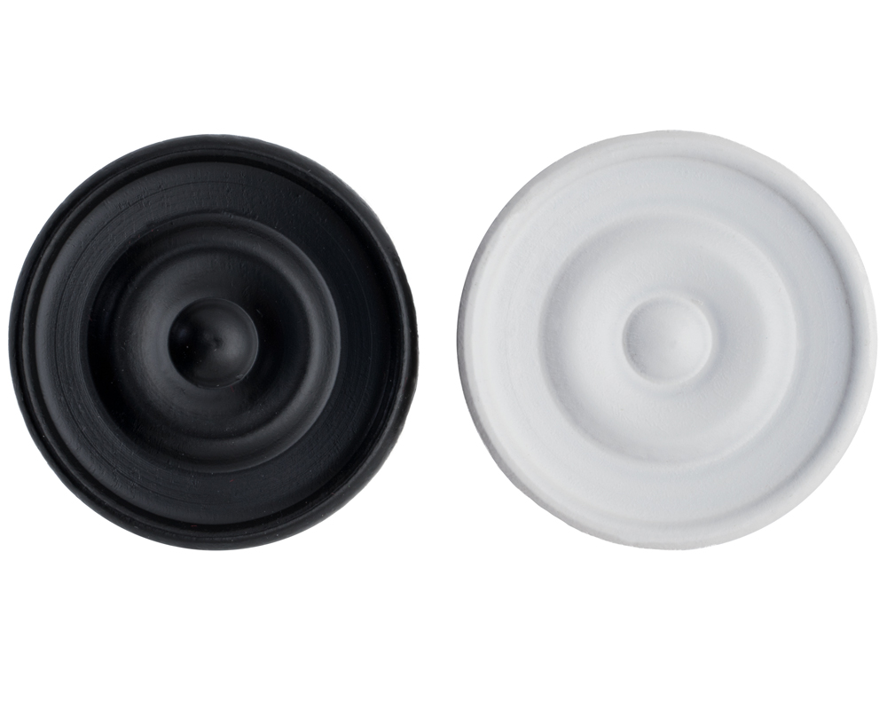
AI plays checkers
Jesus Pardo - 22202392

Slide 2
· Create an AI bot that can play Checkers against other bots or real players. · Create and interface for playing against the AI or see how two AI bots can play against each other.
Introduction

Slide 3
· Create a checkers game and board using the python module pygame. · Use the algorithm Minimax programmed in python 3.9.16 to decide the movements of the AI. · Optimize the algorithm Minimax using Alpha-Beta prunning
Methodology

Slide 4
· Graphics Rendering · Input Handling · Event Management · Animation and Effects · Sound and Music
Methodology: Pygame
· User Interface (UI)
· Game Logic and State Management
· AI Integration
· Customization and Styling
· Cross-Platform Compatibility

Slide 5
· Objective · Two-Player, Zero-Sum Games · Recursive Approach · Maximizing and Minimizing
Methodology: Minimax algorithm
· Depth-Limited Search
· Challenges and Considerations
· Evaluation Function · Backpropagation

Slide 6
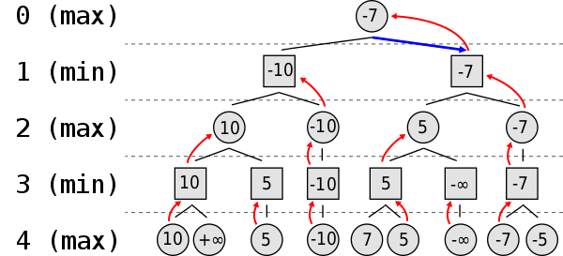
Methodology: Minimax algorithm
Evaluation function:
Max_player pieces - Min_player pieces + (Max_player kings * 0.5 - Min_player kings * 0.5)

Slide 7
· Optimization Objective · Node Evaluation Order · Alpha and Beta Values · Pruning Conditions · Maximizing Player (Alpha)
Methodology: Alpha-Beta pruning
· Minimizing Player (Beta)
· Efficiency Gain
· Depth-First Search:
· Impact on Complexity

Slide 8
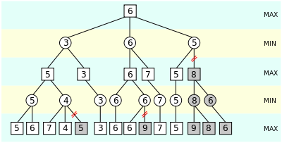
Methodology: Alpha-Beta pruning

Slide 9
· Code Organization and Readability · Modularity and Reusability · Collaboration and Teamwork · Ease of Maintenance · Scalability
Methodology: Repository structure
· Version Control and History
· Documentation
· Testing and Quality Assurance
· Reduced Technical Debt

Slide 10
The game

Slide 11
· Deep Reinforcement Learning (DRL) · Monte Carlo Tree Search (MCTS) · Ensemble Learning · Dynamic Learning Rates · Curriculum Learning · Hierarchical Reinforcement Learning
Possible Extensions
· Reward Shaping
· Exploration Strategies
· Adversarial Training
· Human-AI Collaboration
· Visual Recognition
· Multi-Agent Learning
· Real-Time Learning

Slide 12
Thank you for your attention

